Slide 1
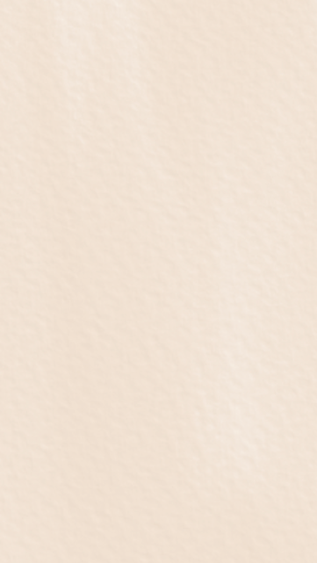


Shes, Theys,
& Plays
Saturday, June 1st 2024
The Producer’s Club
358 W 44th St. New York, NY

Slide 2
Run Of Show
Produced By Baily Renee Fritz & Emily Fischer
Sound Design By Alex Brock
Jehovah’s Witnesses Have Moms Too
Written By Emily Worrell
Directed By Emily Fischer
Performed By Hannah Harper & Jeremy Pinson
Medicine
Written By Ashley Lenox West
Directed By Baily Renee Fritz
Performed By Jessie Maye Christopher & Connor Sink
A Midsummer Night’s Slam
Written By Arianna Rose
Directed By Annaleise Loxton
Performed By Zoe Benjamin, Emi Lulley, & Zara McCord
Se Battre Pour L’amour
Written By Devon Hayakawa
Directed By Jacob David Lang
Performed By Sommer O’Donnell & Mario Noto
Floor Time
Written By Emily Fischer
Directed By Madeleine Bohn
Performed By Meg Johns, Katie Elman, & Stephan Wilson
To Fix A Dinosaur
Written By Emma Rund
Directed By Easton Michaels
Performed By Jonah Harrison & Gabby Badowski

Slide 3
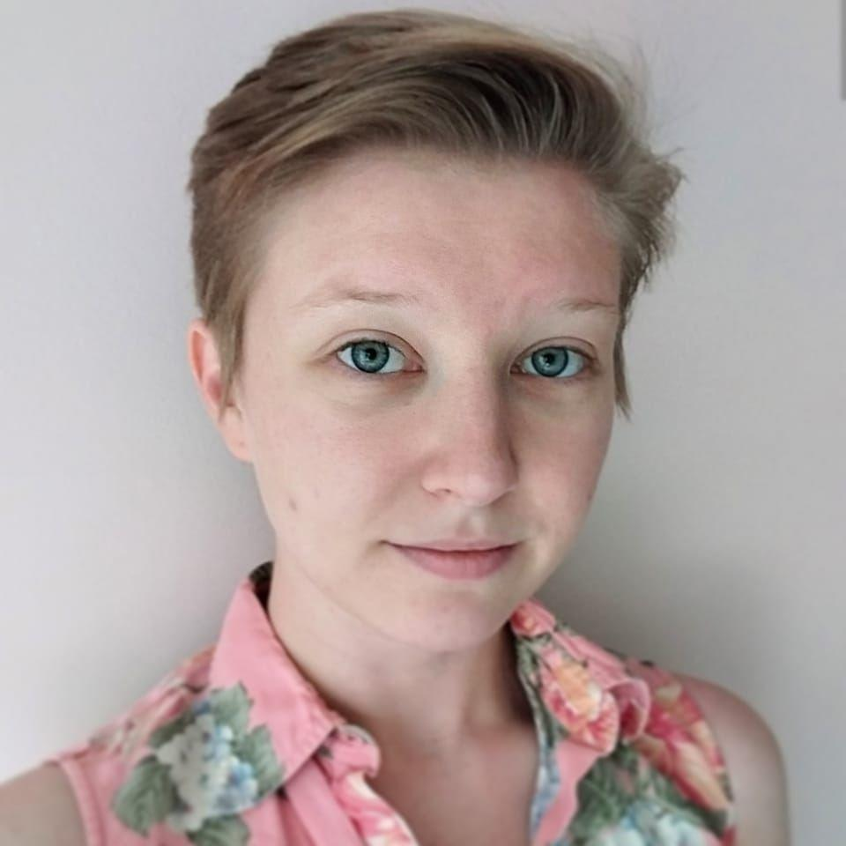
Technical Team
Audio Design By Alex Brock
Alex Brock (she/her) is a New York based sound designer and is super excited to be reuniting with fellow Cardinals on this project! Recent credits include: Stereophonic (Asst- Broadway),
Rachel Bloom: Death, Let Me Do My
Show (Asst-Lucille Lortel/Orpheum
Theaters), Pal Joey and Oliver!
(Asst-NYCC Encores!), Becomes a
Woman (Assoc-Mint Theater Co.),
Weightless (Assoc-WP Theater);
Regional: Cinderella (Cape Fear
Regional Theater), Becky Nurse of
Salem (Assoc-Trinity Repertory Co.),
Escape to Margaritaville (Walnut Street Theater). Alex holds a BS from Ball State Univ. and an MFA from Univ. of Cincinnati CCM.
alexbrocksound.com

Slide 4
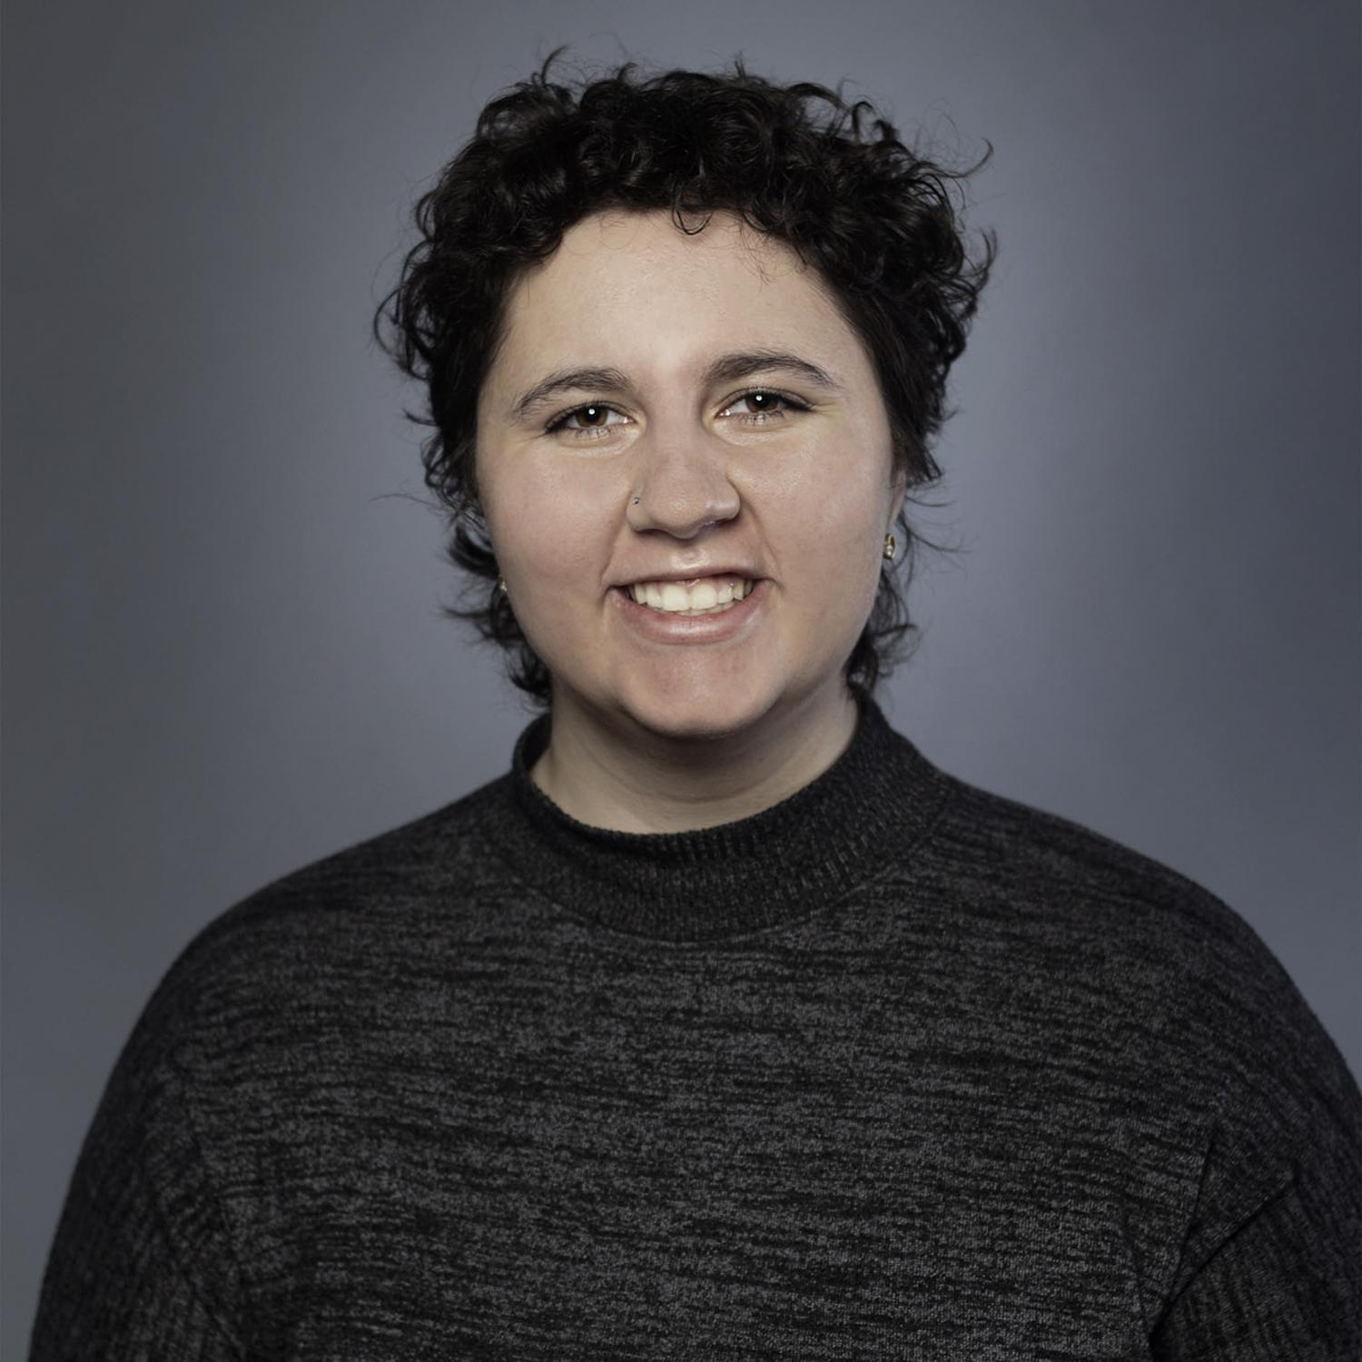
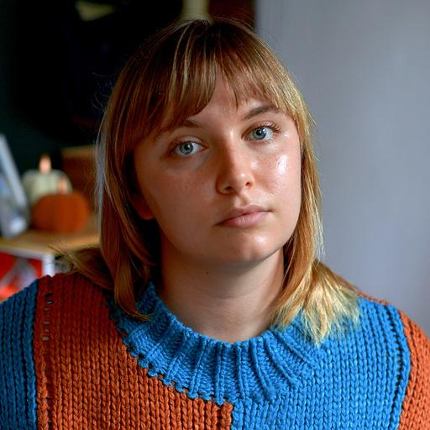
Jehovah’s Witnesses Have Moms Too
Written By Emily Worrell
Emily Worrell (she/her) is a playwright based in Indianapolis, and she is so
excited to be making her NYC debut!
Her plays have been produced around
the country (Indianapolis, LA, West
Chesterfield) and published in short
play magazines. When not writing plays,
Emily can be found working at Pattern
as a Strategic Communications Fellow.
Check out more of her work at https://newplayexchange.org/users/60900/emily-worrell
Directed By Emily Fischer
Emily (“Fisch,” she/her) is a theater and film director who focuses on collaborating with actors, producing projects from concept to final edit, and building a creative community with which to make even more projects.
Since arriving in New York in January
2018, she has created a series of
solo short sketches, directed five
short films (three of which she is also
credited as a writer), and has worked
as a video editor and post-production
producer to pay the bills. Emily’s most
recent project, the short film “Visitors,”
has been selected as a finalist in
the Independent Shorts Awards and
as a semi-finalist in the New York International Women Festival. She is also a co-founder of Mini Mansion Productions.

Slide 5
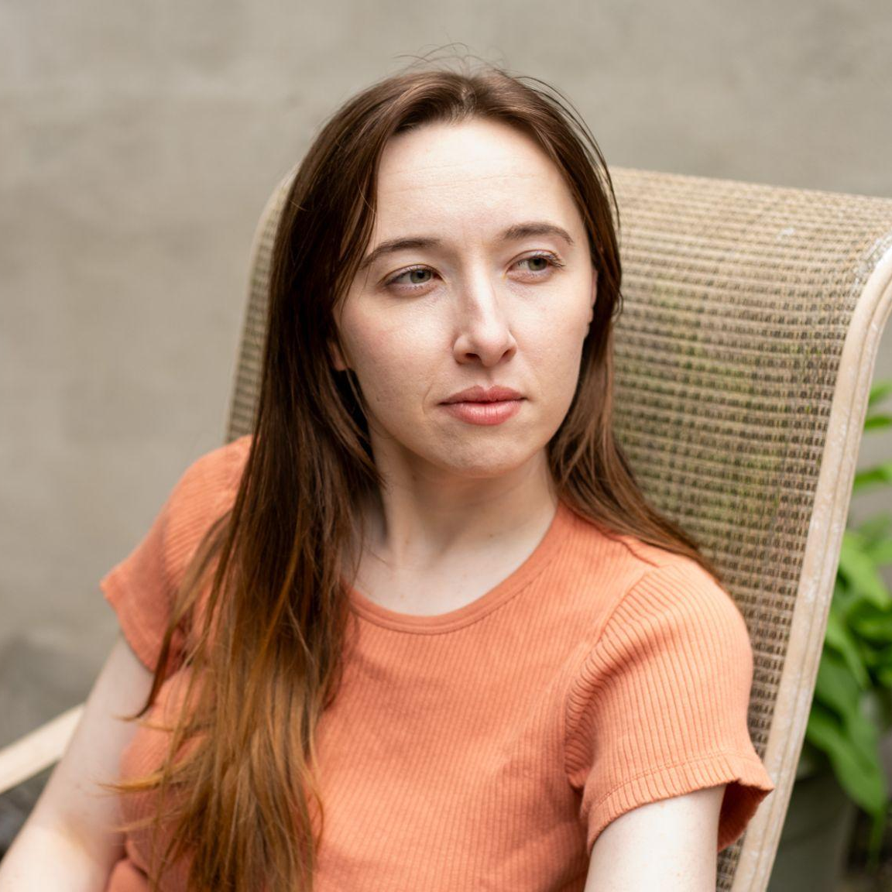
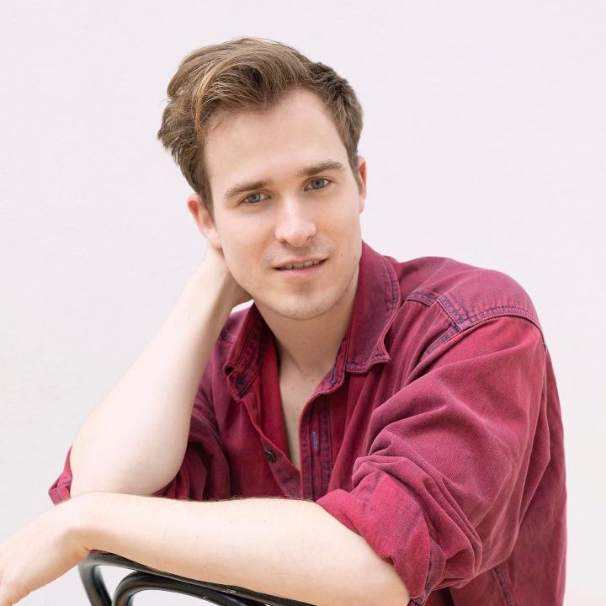
Jehovah’s Witnesses Have Moms Too
Hannah Harper
Hannah (she/her) was most recently seen in Emily Fisher’s short film
“On Paper.” Other credits include Dogg’s Hamlet, Cahoot’s Macbeth (Baker) and Twelfth Night (Chorus) at
Fullerton College. She is ready to
return to the stage after many years
away. Thank you to friends and family
for the support!
Jeremy Pinson
Jeremy Pinson (he/him) is a Brooklyn-based actor, writer, and character comedian. He's done sketch and character shows all across NYC, including his solo show ‘The Hot Folder’ which recently sold out Caveat.
His thesis play 'Shutterbug' won the
Claeyssens Prize for Best Play from
George Washington University.
Jeremy wrote, produced, and directed
the queer "will they, won't they" short
'The Art of Being' which is currently in
post-production.
He's commercially repped by Stewart
Talent and has appeared in ads for
Venmo, Monday.com, and IHG Hotels.
You can usually find Jeremy biking around Brooklyn, volunteering at a community garden, or ordering white wine at the club.
ig: @jer.pinson
jeremypinsonacts.com

Slide 6
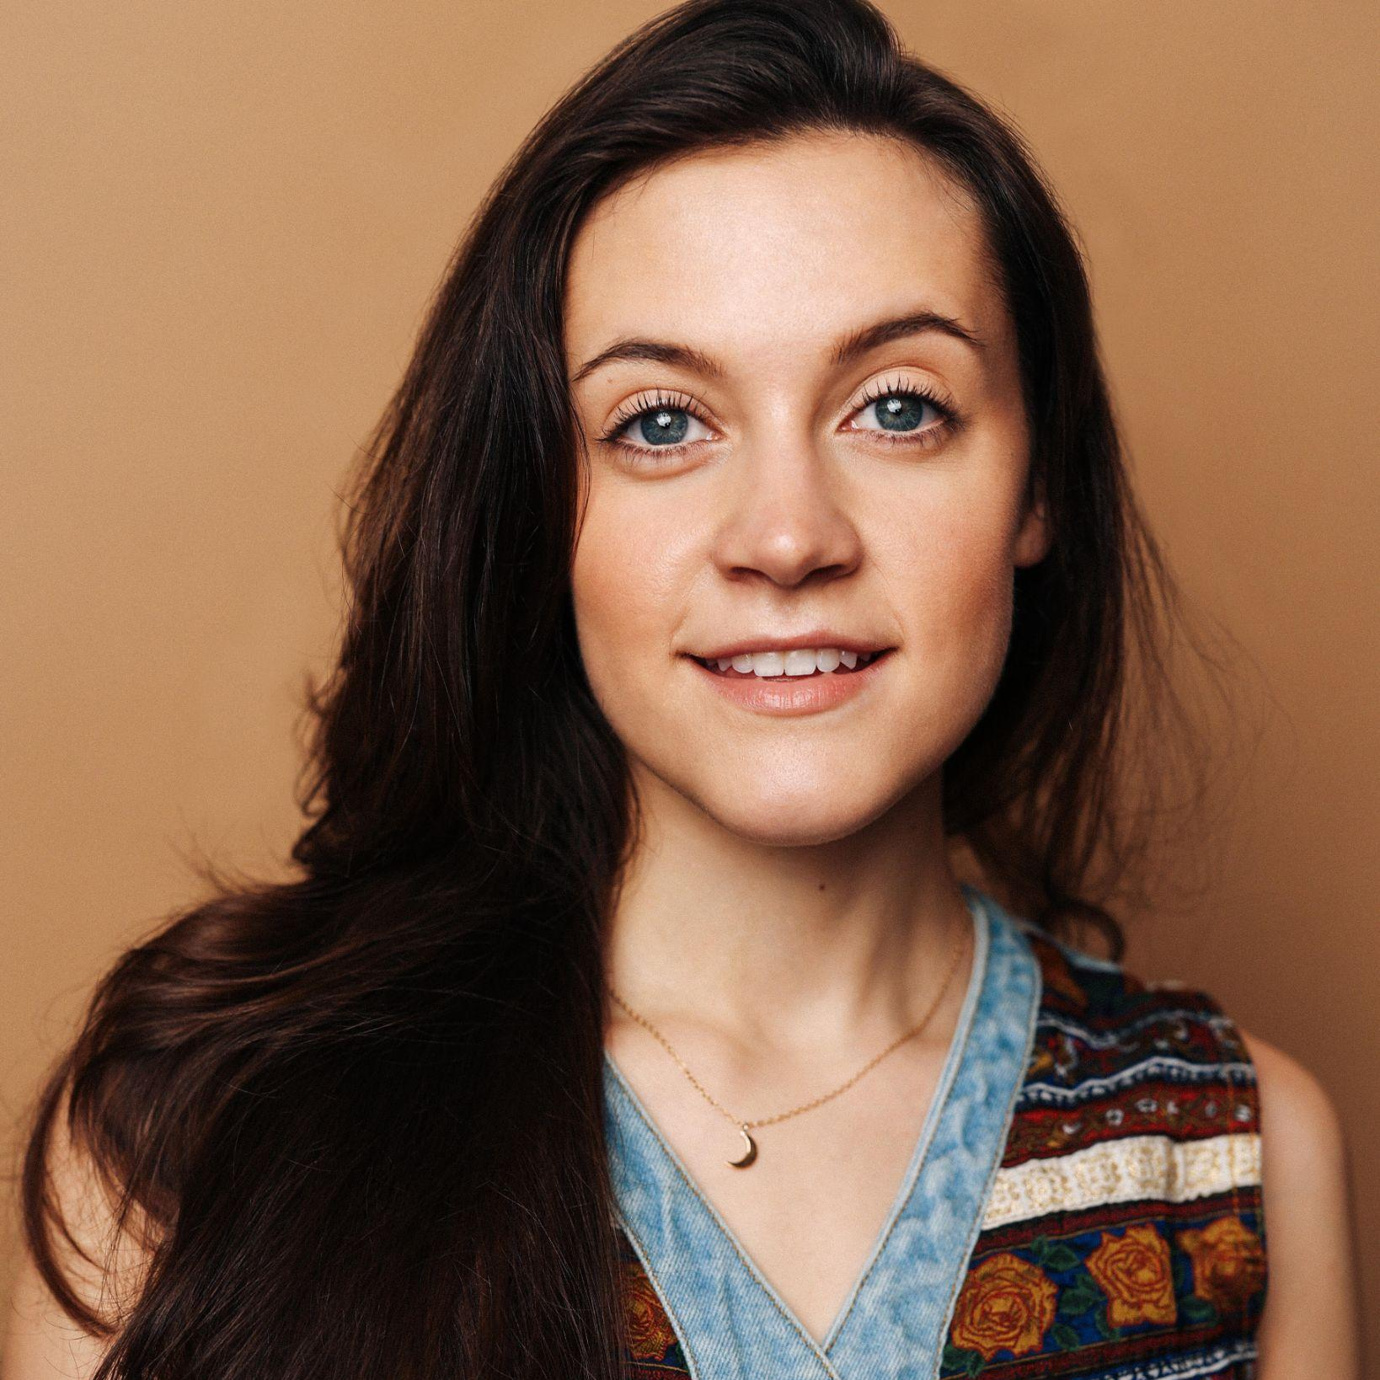
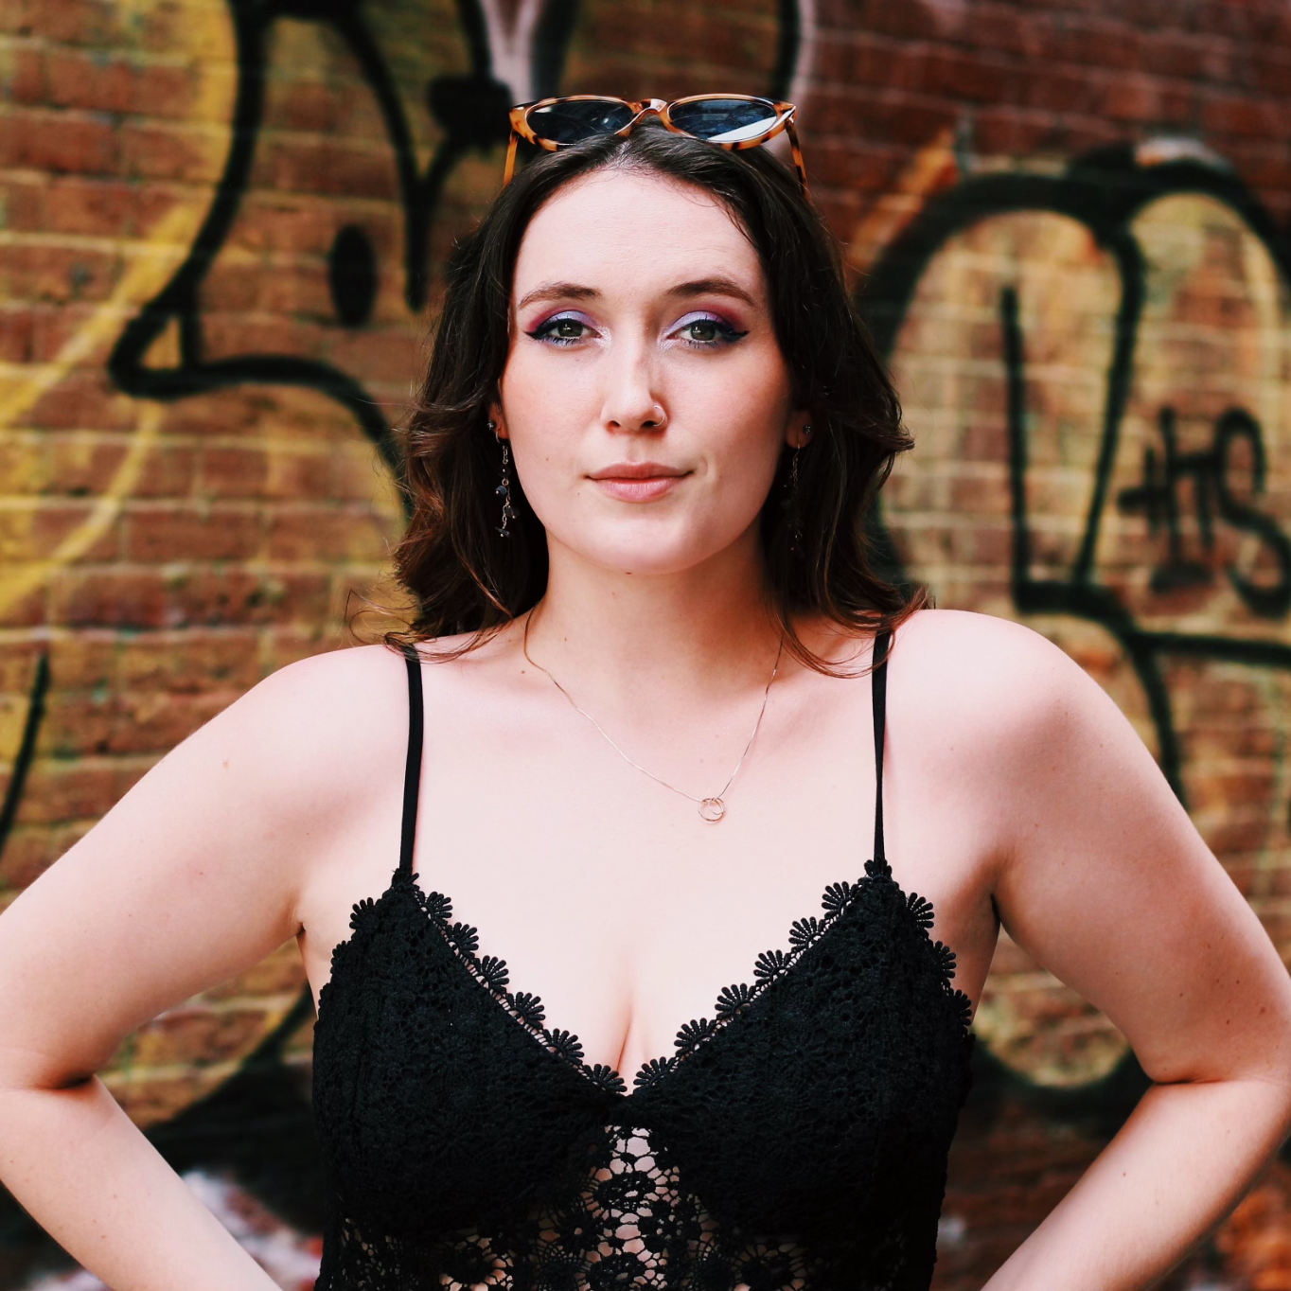
Medicine
Written By Ashley Lenox West
Ashley Lenox West (she/her) was born and raised in the Philly suburbs. She holds a BFA in Musical Theatre with
an Emphasis in Playwriting from
The Boston Conservatory at Berklee.
In her time at the Conservatory she led
New Ground Theater Company as
President; a group dedicated to
producing new plays and musicals of
up-and-coming writers. Her first play,
SIX STEPS WEST, was produced by
Earthstone Theatre Company in the
year 2018. Ashley is now a New York
City based playwright and performing
artist who has a profound dedication to the perfect plate of nachos.
ww.ashleylenoxwest.com // instagram:@splashwest
Directed By Baily Renee Fritz
Baily (she/her) is a full time teacher and director who focuses on telling new stories with an emphasis on those about women.
Directing: “The Larry Ray Show” (Green Room 42), “One for the Road”
(NALPA), “Matterhorn” (Producer’s Club),
“On the Tracks” (Digital Dramatists),
“Personal Library” (Discovery New
Theatre Festival), “Bully” (Ball State
University), “Prism Project”
(Ball State University)..
Film: “Visitors”
(Mini Mansion Productions).
When she isn’t working she enjoys
spending time with her adorable pup,
Olive, crocheting, and watching
horror movies.

Slide 7
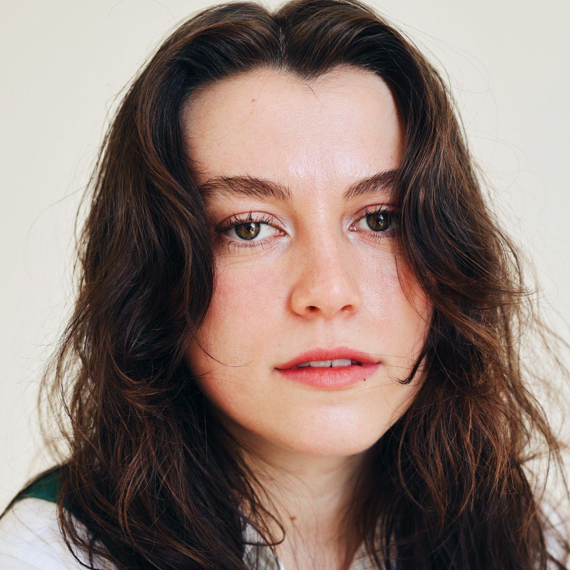
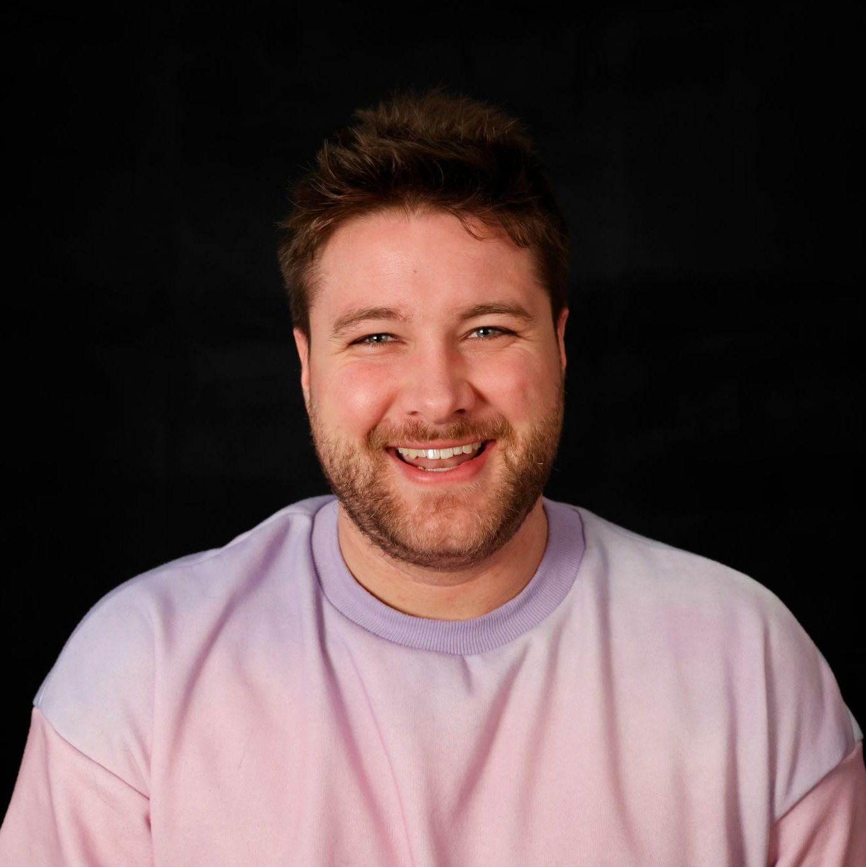
Medicine
Jessie Maye Christopher
Jessie Maye (she/her) is an actor & comedian based in New York City. Some of her favorite credits include Carol (Oleanna), Lenora (Cry-Baby), and Medium Alison (Fun Home). She is thrilled to be
working with Baily and the whole
Mini Mansion team. Jessie Maye can
be seen as Abby in “On Paper,”
a Mini Mansions Productions short
coming soon directed by Emily Fischer.
Jessie is also one fifth of Fleur du Mal,
a hot girl sketch comedy group.
She hopes you enjoy the show and
that you treat yourself to something
sweet afterwards!!!!
Follow Jessie Maye: @jessiemayechristopher
jessiemayechristopher.com
Connor Sink
Connor (he/him) grew up with a love for telling stories.
After graduating from Ball State University with a degree in Digital Media, he moved to NYC to pursue his dream
of working in production.
This is Connor’s first theatre acting role,
most of his experience comes from
working in film and media. He wants to
expand his production knowledge
and build a multifaceted career
in the industry. Most recently, he played
Hoyt in the short film “Visitors,”
a Mini Mansion Production.

Slide 8
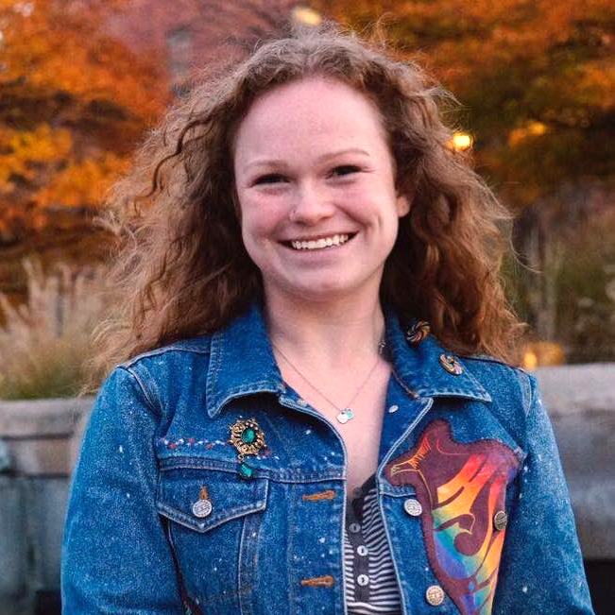
A Midsummer Night’s Slam
Written By Arianna Rose
Arianna Rose (she/her) is an award-winning playwright and musicals writer, produced in 35 states and 9
Countries. 2022 Kennedy Center
Playwriting Intensive and William Inge
Play Festival participant. M.F.A.,
NYU Tisch Musical Theatre Writing
Program. Her plays and monologues
have been published by Applause Books
and Smith & Kraus. She teaches
playwriting for the Dramatists Guild
Institute, and is a Theatre Professor
at Broward College.
www.ariannarose.net
Directed By Annaleise Loxton
Annaleise Loxton (she/they) is a director and producer focusing on new work and artistic development. Directing: "Ordinary Days" (Ball State University), "Songs For A New World" (The Gathering), "BRAVO"
(Discovery New Works Festival), "Julius Caesar", "Pericles, Prince of Tyre"
(Braving The Bard), "Over Heat" (IHRAF),
"Emily/Emily" (Digital Dramatists),
"The Fall Of Anne Boleyn" (One House
Productions, Best Drama Winner), and
"The Carol of Belle" (Possibilities Theatre
Co.) She is the Research and
Development Manager at Meraki and an
Associate Producer on "Your Lie In April"
(West End 2024). Annaleise currently
serves on the TCG Next Generation Task
Force Board and is a proud member of both Ring of Keys and SDC. @myheroannaleise annaleiseloxton.com

Slide 9
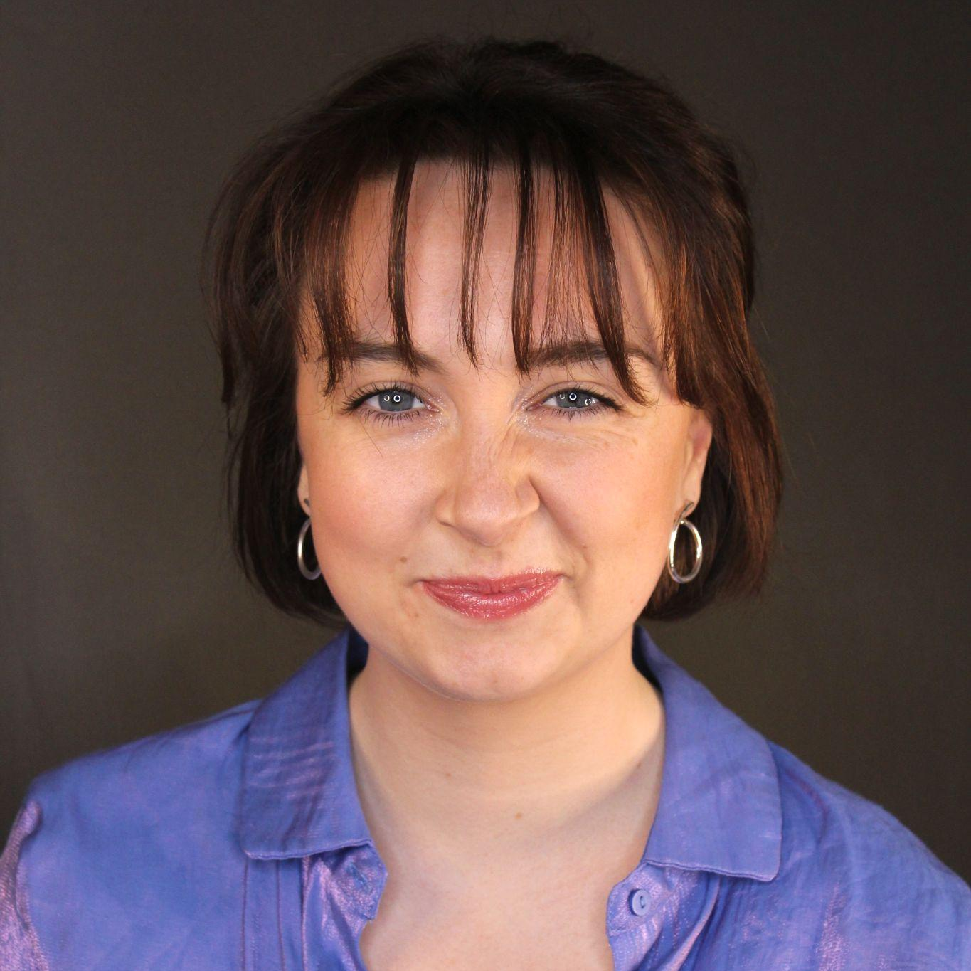
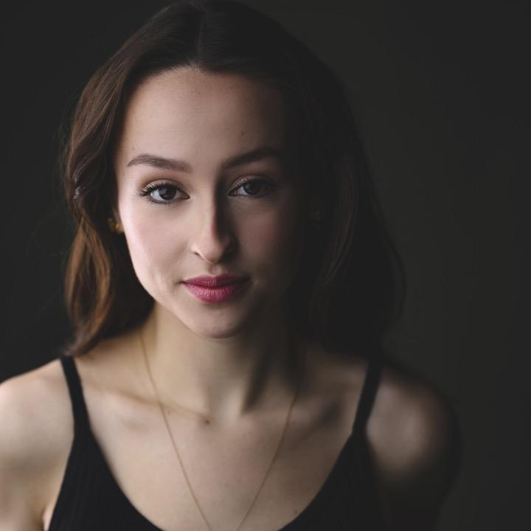
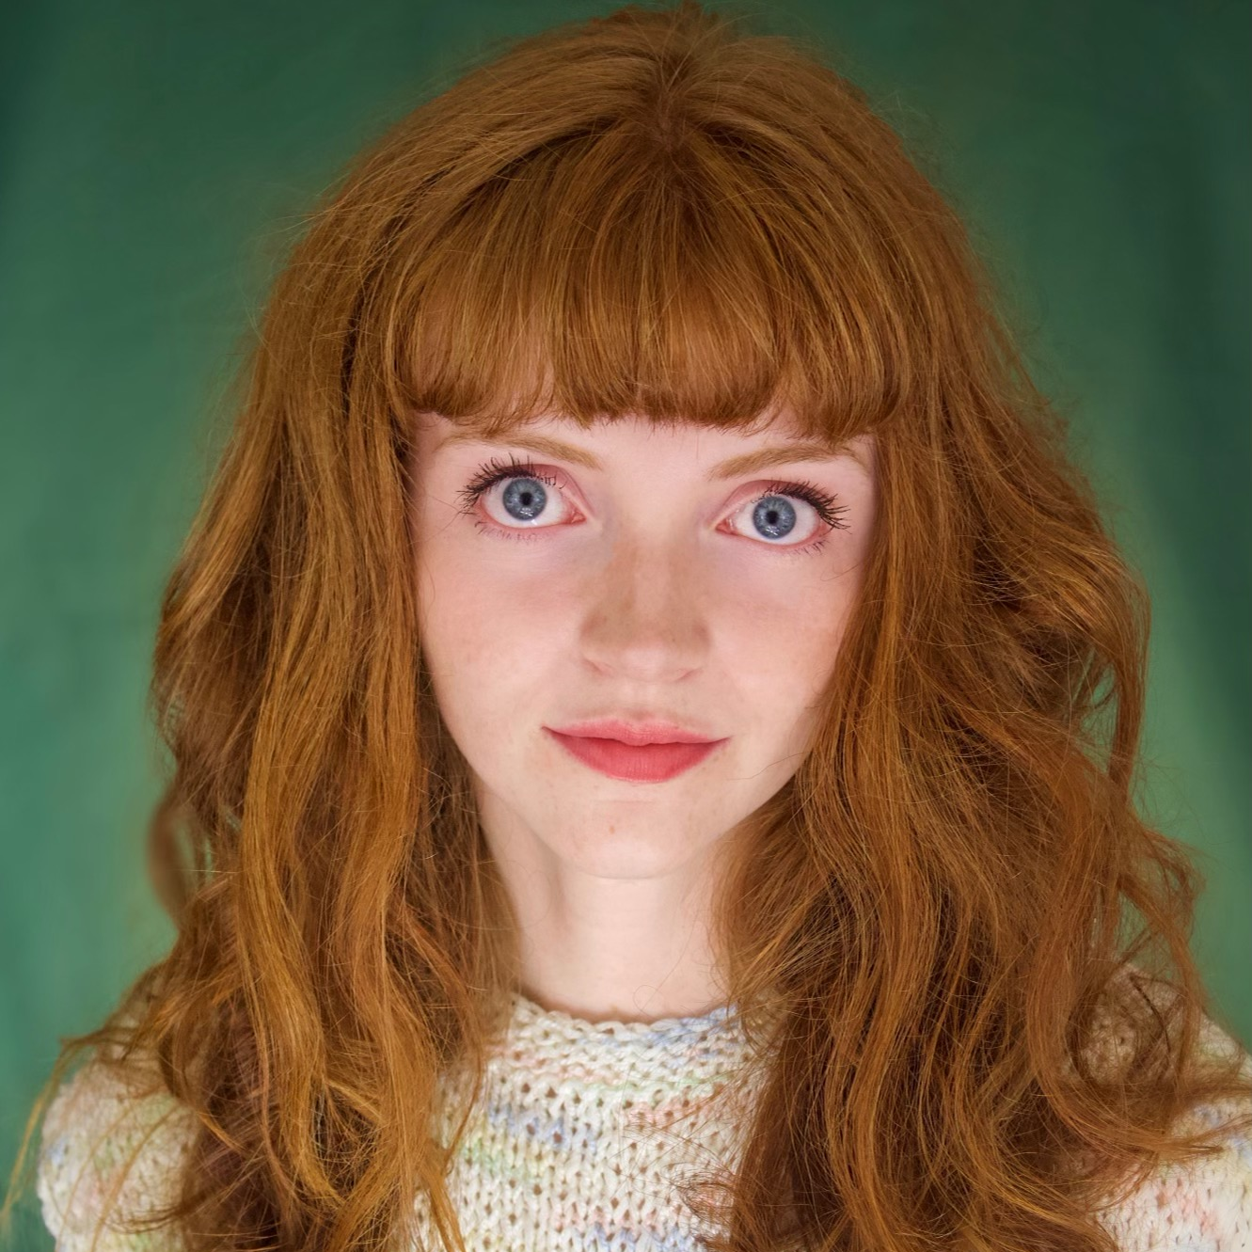
A Midsummer Night’s Slam
Zoe Benjamin (she/her) is a queer artist from Connecticut with a passion for telling stories through movement, speech, and song.
A graduate of Ball State University and Broadway Dance Center's Professional Semester, she has a commitment to creating as well as performing. Her favorite projects so far have been working as a dancer and stilt walker at Cedar Point in Ohio, being a dance captain for Kellen Stancil's piece in the BDC Pro-Sem showcase, and playing Jo March in Little Women. When she's not doing theatre or dance, Zoe loves to write songs, spend time in nature, and hang out with friends. She is excited to continue growing a career in NYC!
@zoe.benjamin
Emi Lulley (they/them) is a New York Based actor, born and raised on Long Island. They recently obtained their B.F.A. in Acting from Ball State University in Muncie, Indiana. Since returning from their midwest vacation, Emi has been seen as Helen, in the first staged reading of No Entrance, an on stage swing in the Argyle Theatre’s Production of The Happy Elf, and various small film projects. Emi would like to thank their family and friends for the undying support in pursuit of their dreams. @emiin.nyc
Zara McCord (she/her) is thrilled to say she is now local to NYC! She is geeked to be on this project joining friends and meeting fresh faces. If you’re reading this at She, They, and Plays Festival, there’s a chance you might have spotted her in a targeted social media ad for Opill, which happens to be her commercial debut! After earning her BFA in Acting from Ball State University in 2023, Zara has also made appearances on The Daily Show and contributed to a production in Chicago. You can find more of her on instagram: @pizza.king.girl

Slide 10
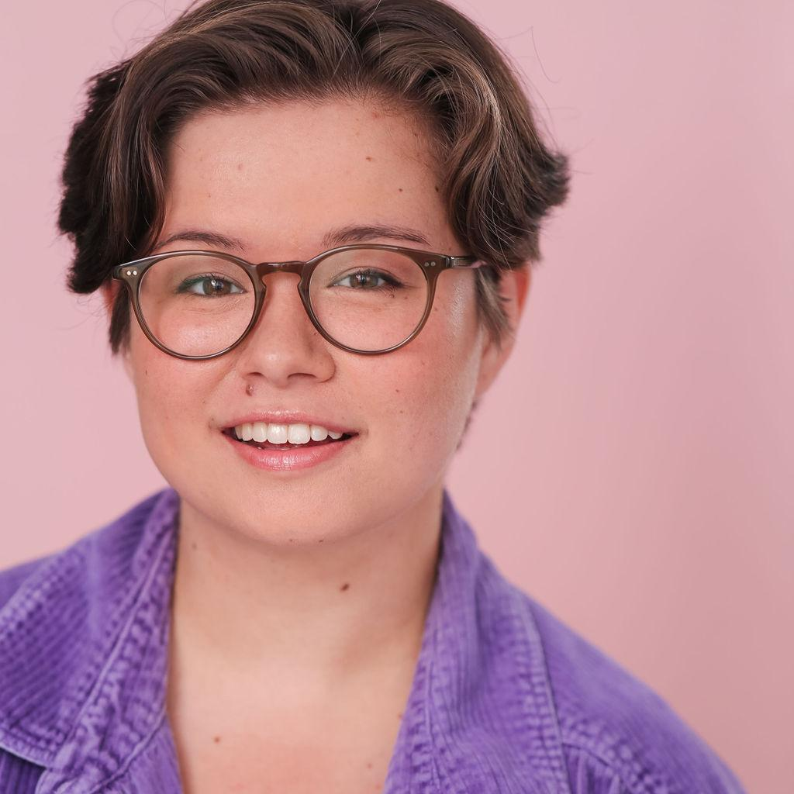
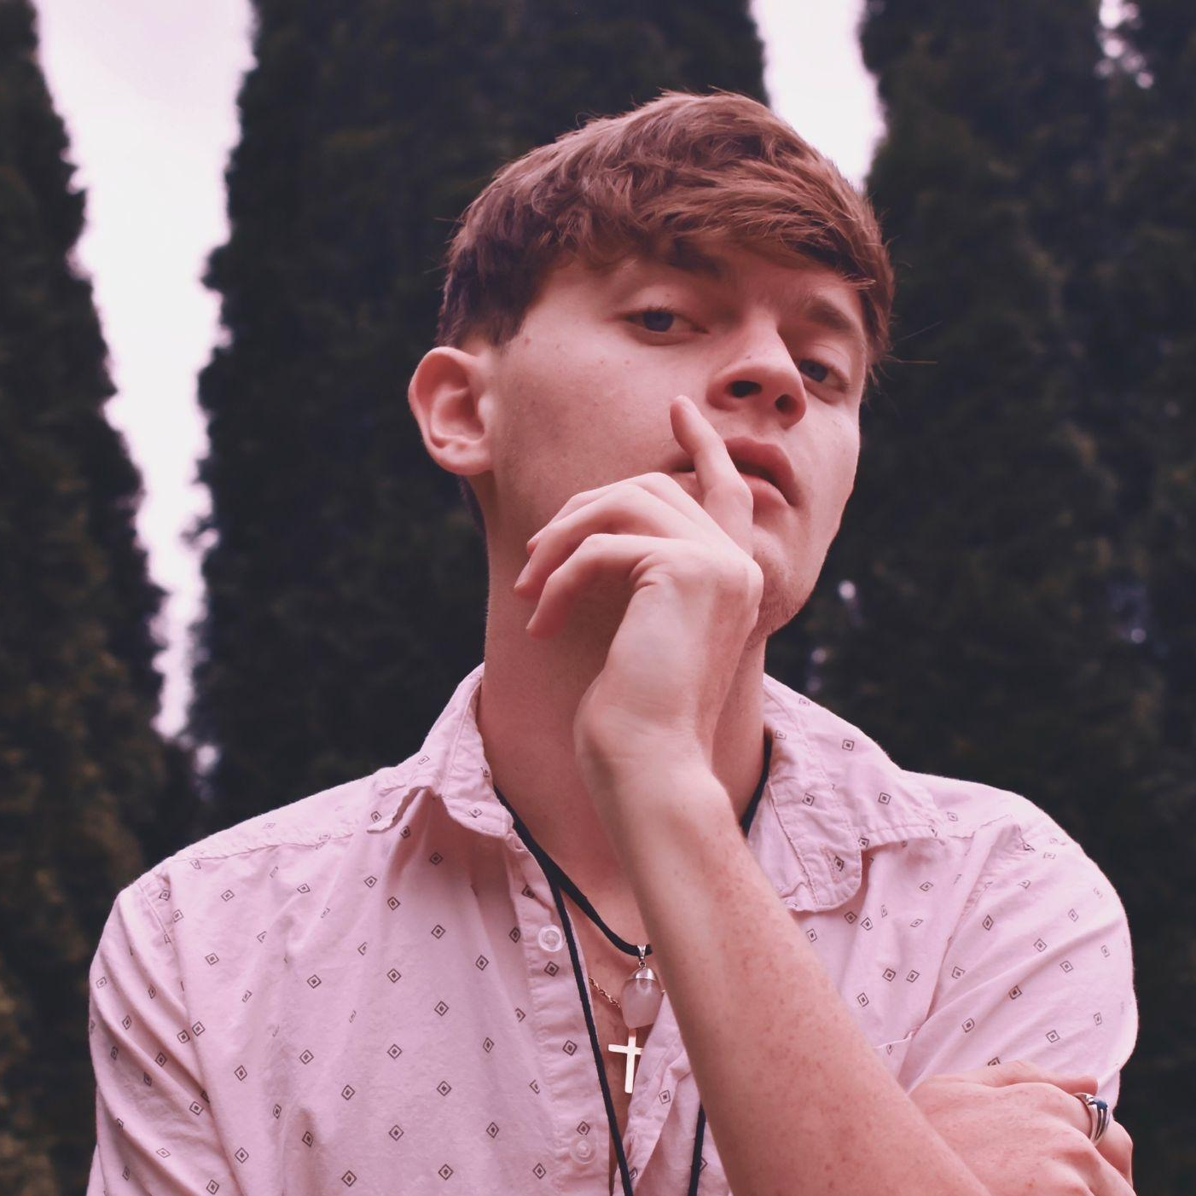
Se Battre Pour L’amour
Written By Devon Hayakawa
Devon Hayakawa (any pronouns) is a multidisciplinary theatre artist based in Chicago. Their work has been seen
onstage and off at Paramount, Chicago
Shakespeare Theater, Goodman, Drury
Lane, Remy Bumppo, Theo Ubique,
Bramble, Babes With Blades,
The Plagiarists, Metropolis Performing
Arts Center, and Chicago Dramatists.
Most recently, they were commissioned
to write a play centering AAPI voices
for a high school's theatre department,
which has since then had workshops with additional theatre groups.
For more, visit devonhayakawa.com.
Directed By Jacob David Lang
Jacob David Lang (he/him) is incredibly excited to be working in NYC for the first time as the Director of 'Se Battre Pour L'Amour'.
He previously directed 'Animal Control'
in American Lives Theatre's Short and
Stout Play Festival and assistant
directed their production of
'The Minutes'.
He also assistant directed 'Beauty and
the Beast' at Drury Lane in Chicago.
He thanks his family and friends for
their continued support.
jacobdavidlang.com

Slide 11
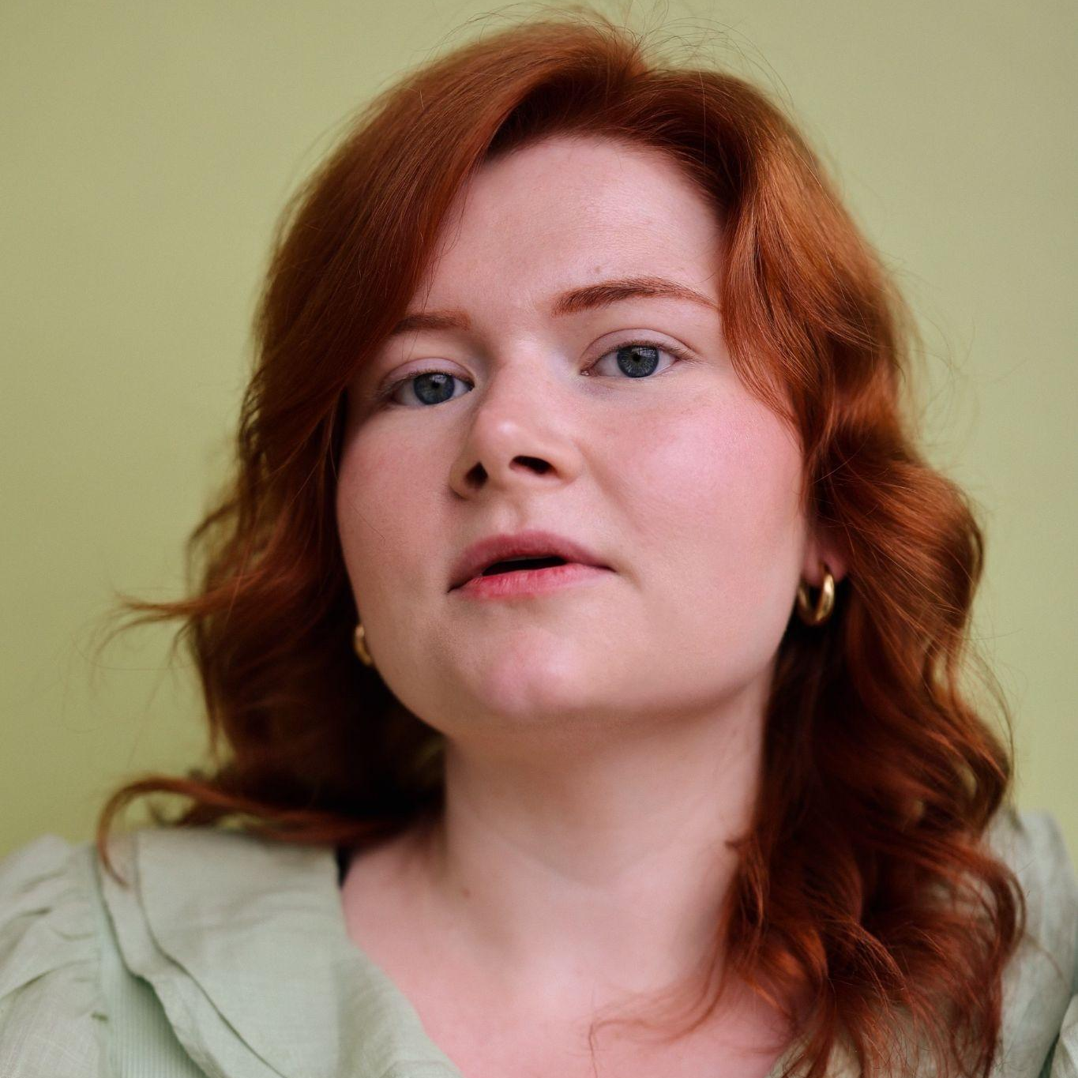
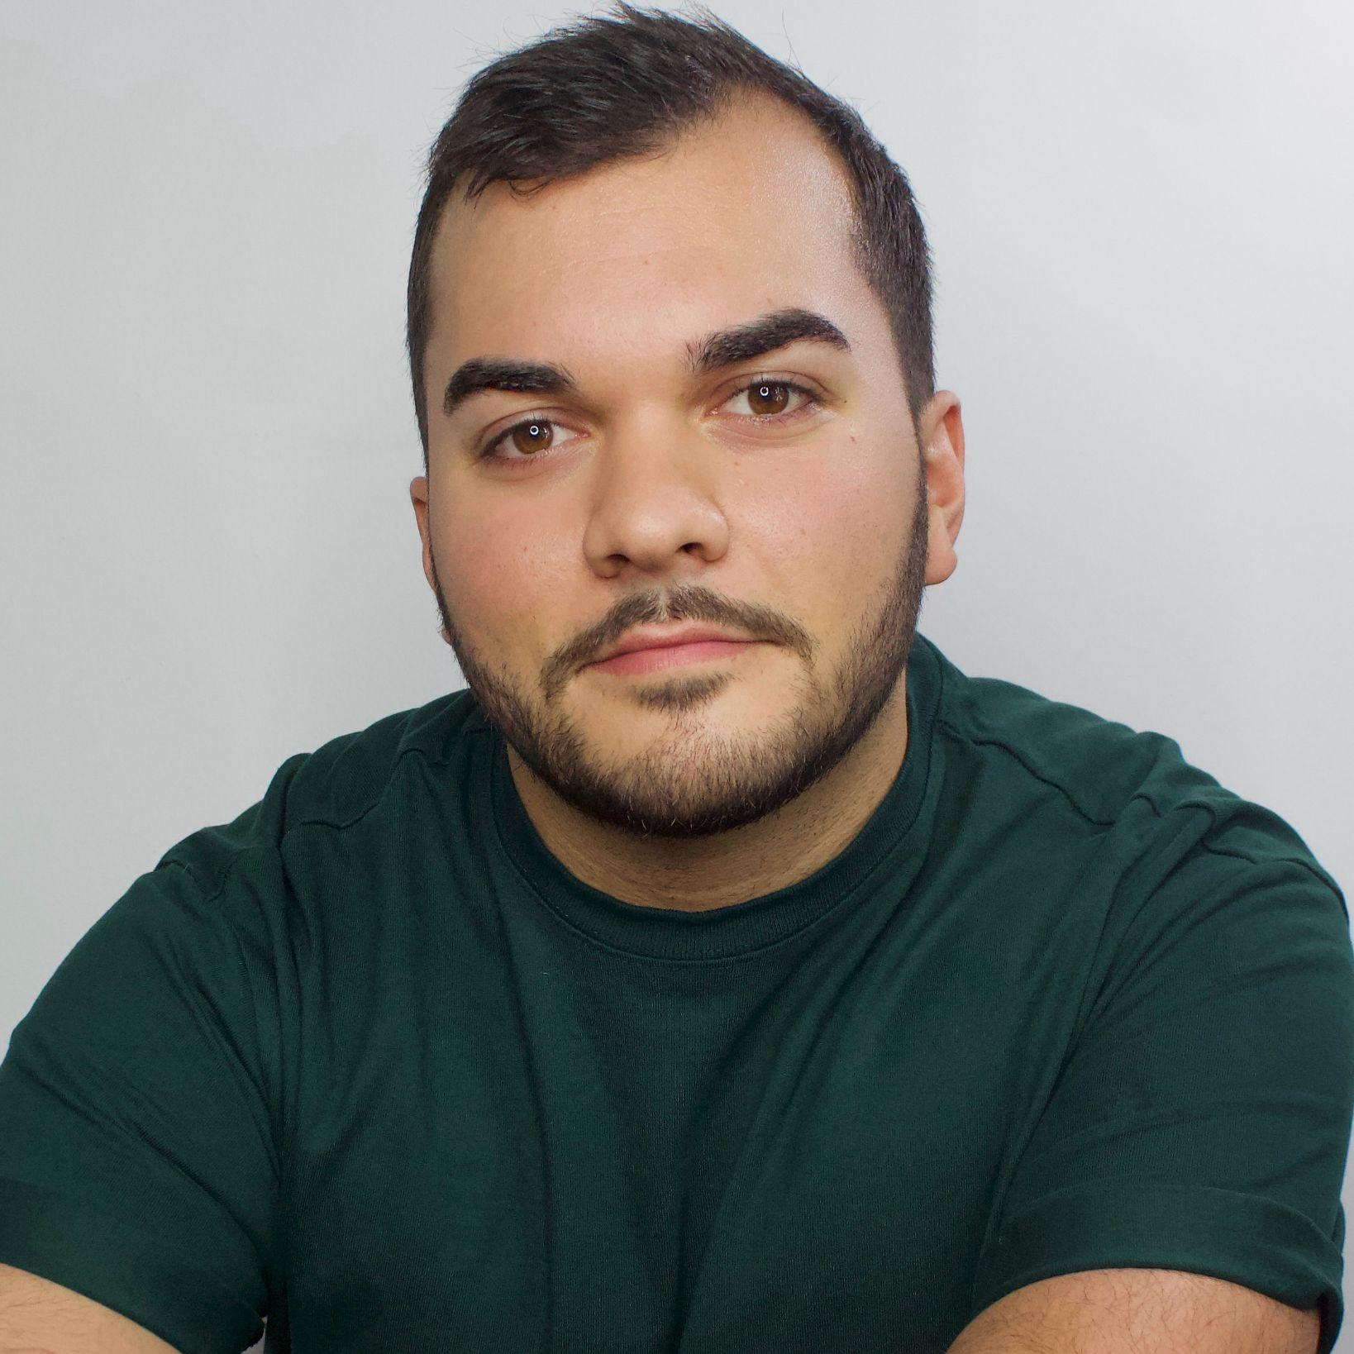
Se Battre Pour L’amour
Sommer O’Donnell
Sommer (she/her) is an actor and educator based in Manhattan. She earned her BFA in Musical Theatre
From Ball State University and credits
Include Ordinary Days (Claire),
Mamma Mia (Rosie), and Songs for
a New World (Woman #2).
Mario Noto
Mario Noto (he/his) is a NYC based actor and alumni of Ball State University where he earned his BFA in Acting.
Off-Broadway credits include
Admissions (The Chain Theatre) and
The General (The Tank). Mario was
most recently seen on tour with
Hudson Valley Shakespeare Festival’s
production of Much Ado
About Nothing.
@mario.noto

Slide 12
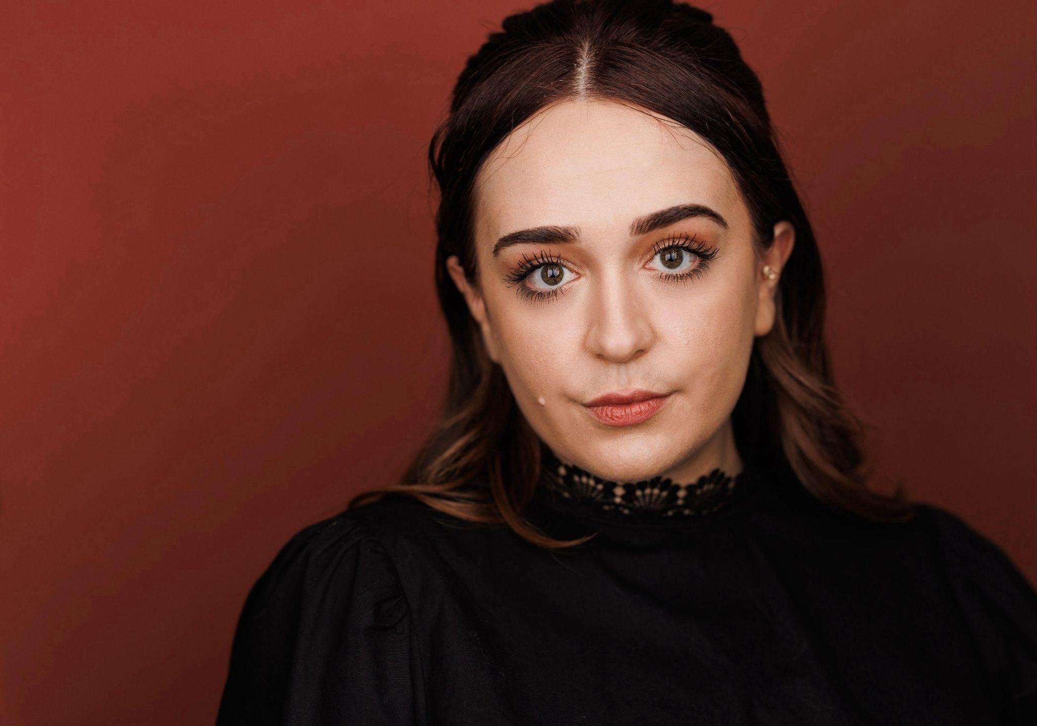
Floor Time
Written By Emily Fischer
Emily (“Fisch,” she/her) is a theater and film director who focuses on collaborating with actors, producing projects from concept to final edit, and building a creative community with which to make even more projects.
Since arriving in New York in January
2018, she has created a series of
solo short sketches, directed five
short films (three of which she is also
credited as a writer), and has worked
as a video editor and post-production
producer to pay the bills. Emily’s most
recent project, the short film “Visitors,”
has been selected as a finalist in
the Independent Shorts Awards and
as a semi-finalist in the New York International Women Festival. She is also a co-founder of Mini Mansion Productions.
Directed By Madeleine Bohn
Madeleine (she/her) attended the American Academy of Dramatic Arts (AADA) in New York City and received a BS in television and film production from St. John’s University
In Queens, NY. A Michigan native,
Madeleine has extensive theatrical
experience writing, directing, and
acting in shows including: The Insects
(Under St. Marks, NYC); Exit, Pursued
By a Bear; and Meet Me in the Woods
at Nightfall (Six Eleven Theatre
Company, Chicago).
www.madeleinebohn.com

Slide 13
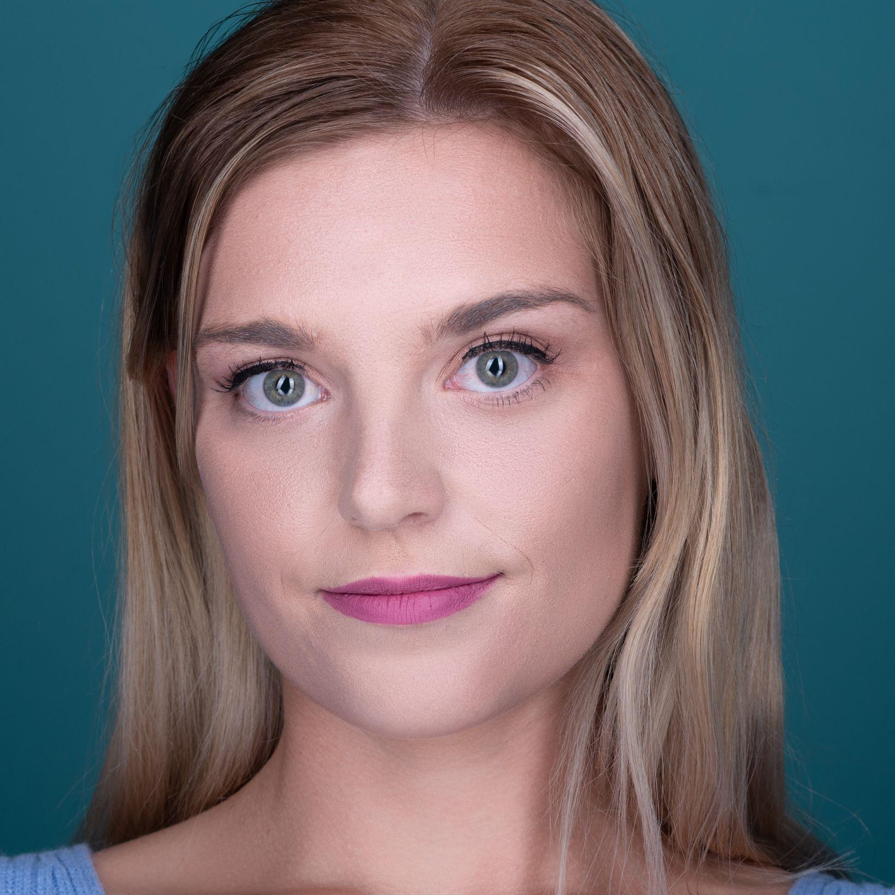
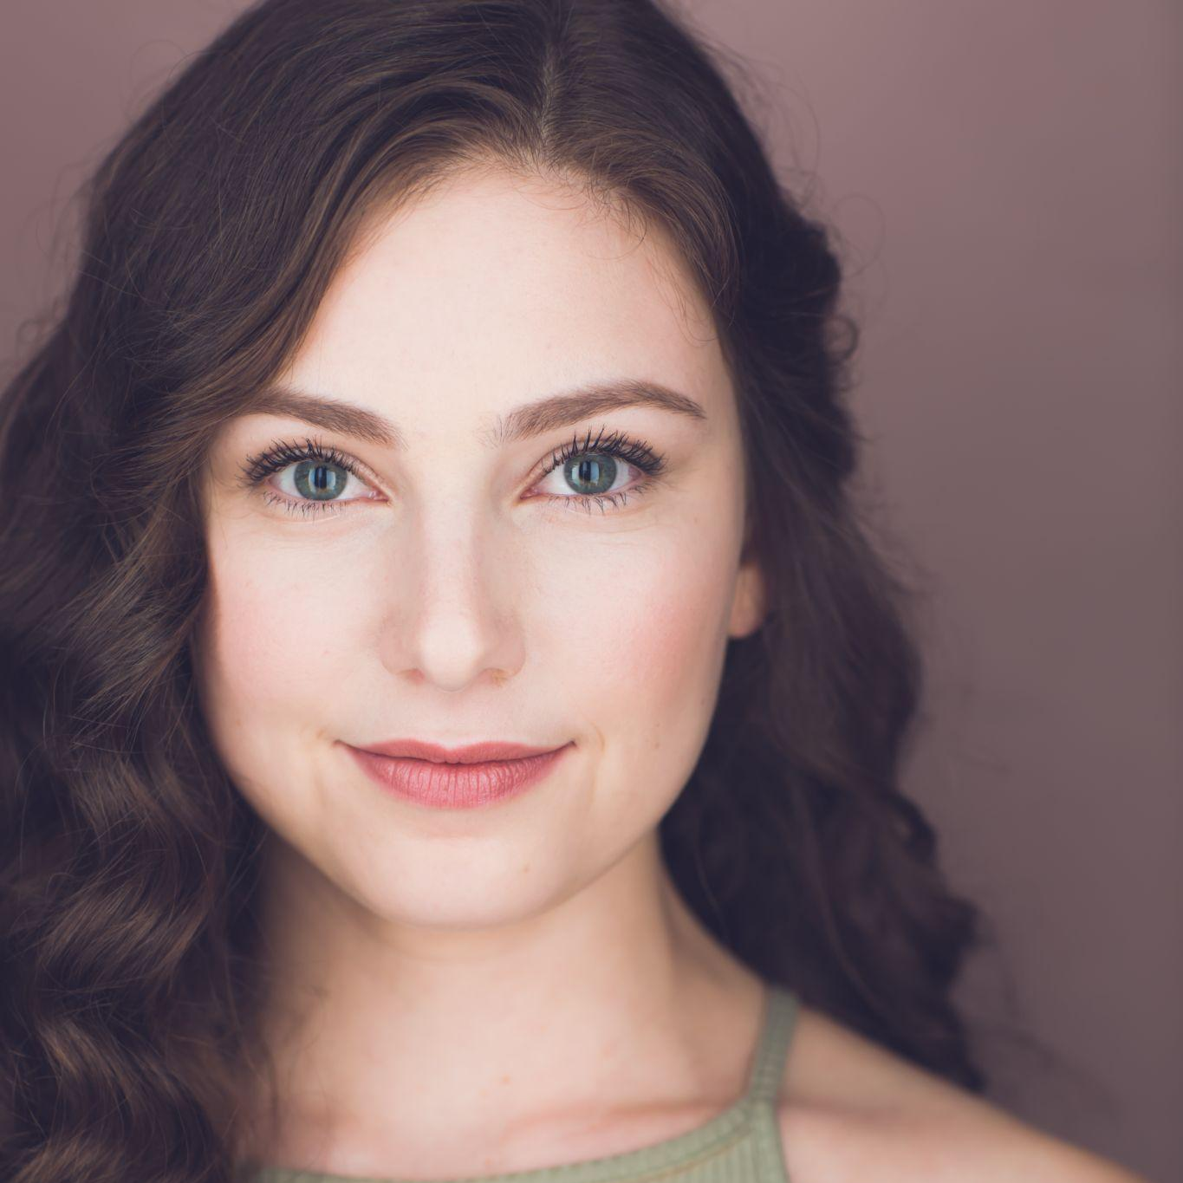
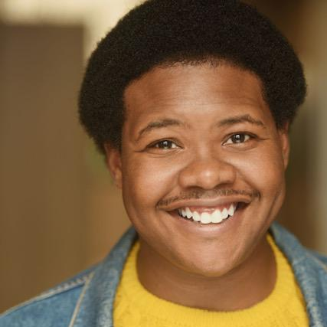
Floor Time
Meg Johns (she/her) is a New York City-based actress originally from Grand Rapids, Michigan. Meg has performed in numerous productions throughout New York City, Atlanta, and a National Tour. Favorite theatrical credits include The Wild Party (Broadway World Nominee: Best Supporting Performer in a Musical/ Jennie T. Anderson Theater), Feeding Beatrice (Aurora Theatre), Christmas Canteen (Aurora Theater), Airborn (Apples and Oranges Arts), and The Cat in the Hat National Tour (Theaterworks/ Two Beans Productions). Favorite Film & Television Credits include Lethally Blonde (Investigation Discovery Channel, Mean Girl Murders (Investigation Discovery Channel), and Cornelius (Bronx Film Festival: Best Film). www.megjohnsactress.com
Katie Elman (she/her) is so queer she curated a comprehensive Google Doc outlining all NYC lesbian/sapphic spaces & events for Pride last year. (DM me if you want it! @katie_elman). Recent credits include: Off-Broadway: The Office! A Musical Parody (Angela & Others), Regional: Skyline Theatre Company – Little Women (Beth March), Goodspeed Musicals – The Proxy Marriage (Gillian), Peregrine Theatre Ensemble – Cabaret (Lulu). BFA Musical Theatre from The Hartt School.
Find her at www.katieelman.com!
Stephan JoQuan Wilson (he/him) is a proud product of Flint, Michigan with a BFA in Musical Theatre from Central Michigan University, Fire Up Chips! His regional credits include: Drifter in “Beautiful: the Carole King musical” (Aurora Theatre), Adam in “The Color Purple” (City Springs Theatre Company), Ziggy in “Bob Marley’s Three Little Birds” (Synchronicity Theatre), Frog in “A Year with Frog and Toad” (Cardinal Stage), and Sky Square in “Polkadots: the Cool Kids Musical” (Festival 56). He would like to thank his mentors, friends, and family for their love and support as he continues to follow his dreams. Follow his journey on instagram @stephanw921

Slide 14
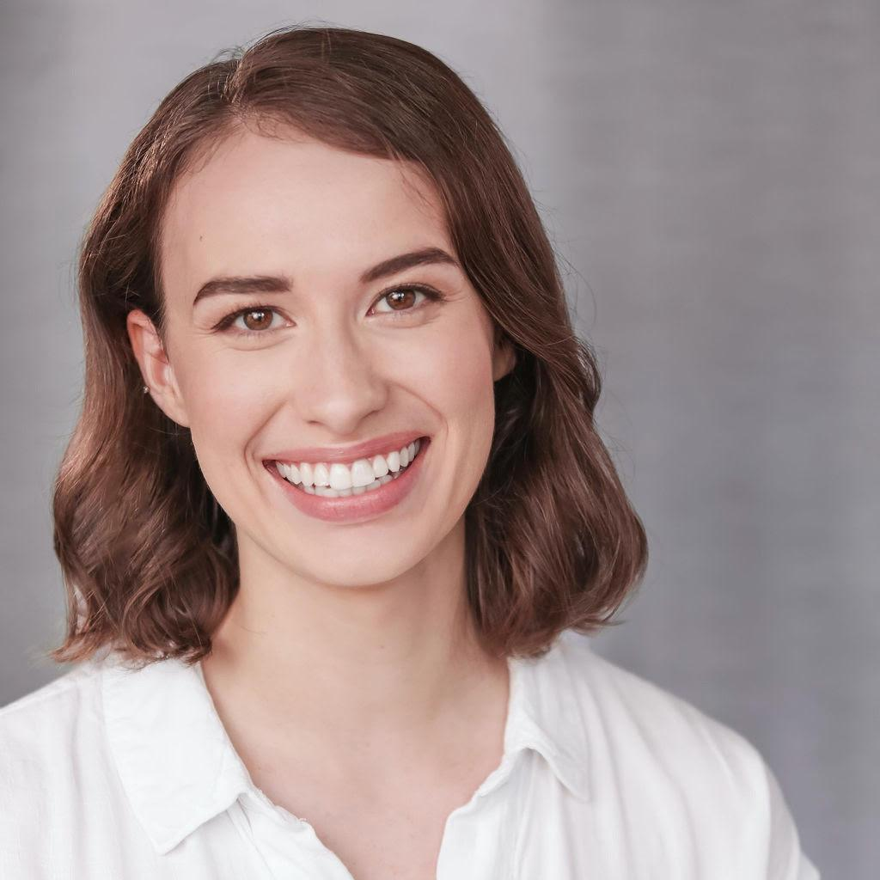
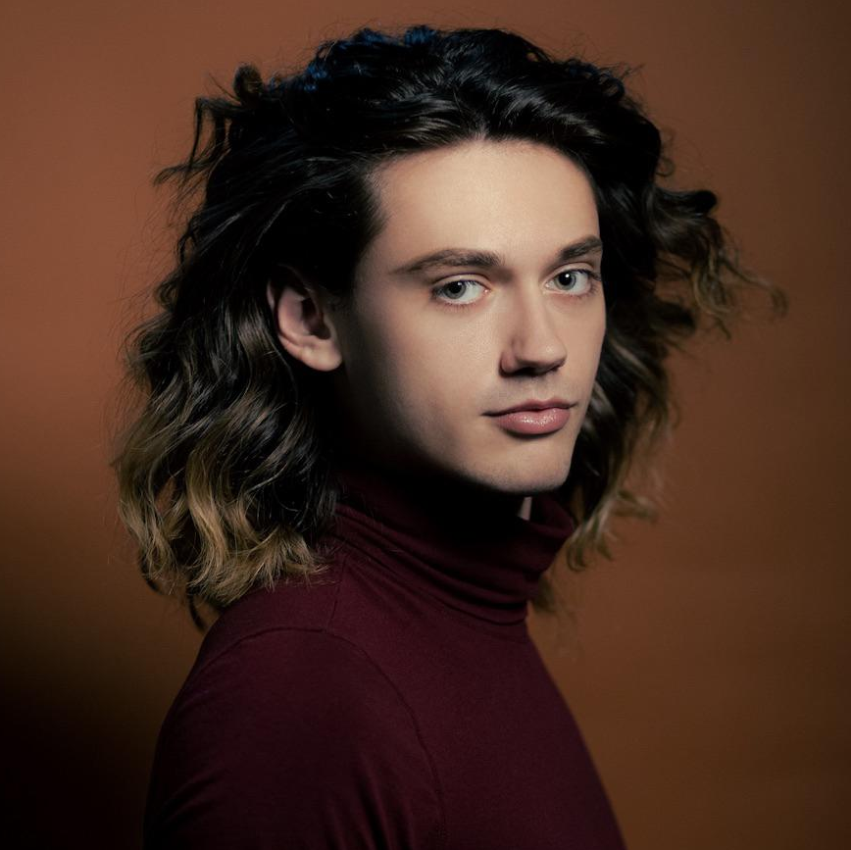
To Fix A Dinosaur
Written By Emma Rund
Emma S. Rund (she/her) is a Chicago-based playwright, actor, and avid reader passionate about the power of live theatre to share truth.
As Tim O'Brien so beautifully wrote in
The Things They Carried, "I want you to
feel what I felt. I want you to know why
story-truth is truer sometimes than
happening-truth." She’s had the pleasure
of workshopping her plays with Women’s
Theatre Alliance, Wayward Sisters,
Actors Theatre of Indiana (ATI),
the Rogue Theatre Festival, and more.
You can find Emma’s work on NPX
and on her website www.emmasophierund.com.
Directed By Easton Michaels
Easton (they/she) is a Brooklyn based performer, director and drag artist. Most notably performing as The Scarecrow in Zi Alikhan’s fantastically queer re-imagining of “The Wizard of Oz”,
starring opposite Rosé (RuPaul’s
Drag Race) as Glinda.
In the realm of directing/
choreography, Easton has helmed
productions of “The Prom” and
“Little Shop of Horrors”, as well as
choreographed the world premiere
of “Skin and Bones, a New Musical.”
They are currently attached to direct
a workshop production of a new play
by Jonah Harrison, “The Man Of My Dreams Lives In West Hollywood.”

Slide 15
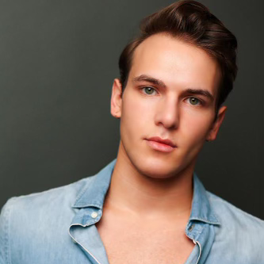
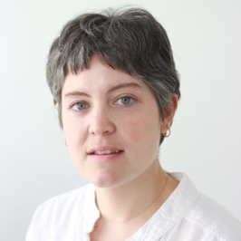
To Fix A Dinosaur
Jonah Harrison
Jonah Harrison (he/him) is an actor/playwright based in Brooklyn, NY.
He has performed at the Hangar Theater in Ithaca, Theater Latte Da and the History Theater in the Twin Cities.
His new play, The Man of My Dreams
Lives in West Hollywood will be
presented as part of
The Tank’s PrideFest this June.
Gabby Badowski
Gabby (she/her) grew up on the stage. She started dancing at age 7 and discovered acting at age 12. After her first production of Annie Jr. with a local children’s theatre group, K.I.S.S. (kids innovating stage & sound) she was hooked. During her college years,
theatre took a back seat. She went on
to earn a degree in Culinary Arts and
Applied Food Studies at the Culinary
Institute of America, but always felt like
something was missing. In 2022,
she got back into acting on a whim by
taking a beginner’s technique class at
the T. Schreiber Studio under the
instruction of Tommy Buck. It only took
one class to reignite her passion for theatre and she continues to train at
T. Schreiber today. In addition to acting, Gabby enjoys writing
(she’s currently working on a screenplay), cooking with her wife Elena, and lifting heavy shit.

Slide 16
About Mini Mansion Productions
We are a volunteer based group whose main goal is to have fun in a creative environment in which we can grow in
storytelling together.
We began as a small group of midwestern transplants who wanted to create films together and have since grown our network exponentially into the collaborative team we are today.
Mini Mansion produces short films, sketches, theatrical performances, and anything we can get our hands on.
Visit
https://www.minimansionproductions.com
to learn more about our projects.

Slide 17
Thank You!
Jennifer & Mike Fritz
The Producer’s Club
Production Junction
All Of You!

